Slide 1






Semantic Knowledge Commons for Climate Change
MPhil Computational Biology, 2022, Cambridge, UK, 2022-10-19
Peter Murray-Rust
Yusuf Hamied Dept of Chemistry, Univ of Cambridge
Shweata N Hegde, Ananya Singha, Ayush Garg
Associated with Nat. Inst. For Plant Genome Res. (IN)
Axel Duerkop
https://semanticclimate.github.io/p/en/
pm286@cam.ac.uk
Images from ContentMine CC BY and Wikimedia CC BY-SA

Slide 2

Global Crises: UN Sustainable Development Goals
Hunger
Health
Water
Climate
https://sdgs.un.org/goals

Slide 3
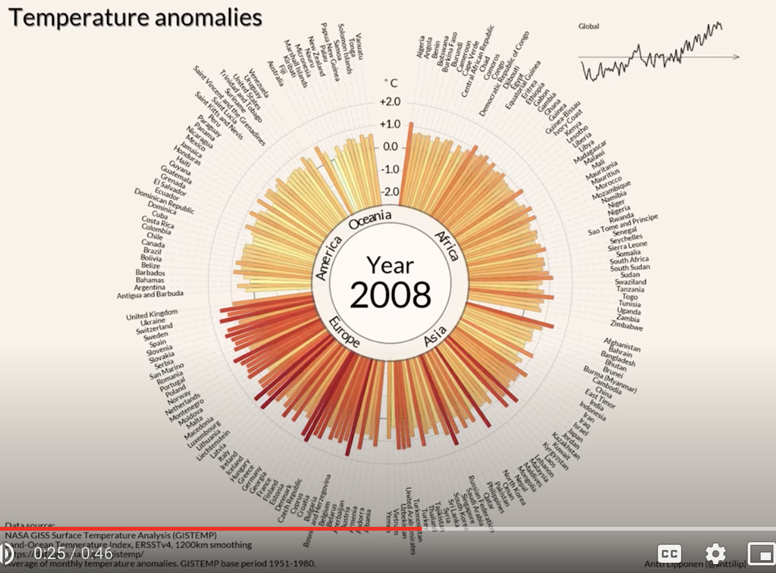
climate
Data that cannot be ignored
Antti Lipponen (@anttilip) of the Finnish Meteorological Institute based on GISTEMP data (CC BY 2.0).
https://twitter.com/dwallacewells/status/1312121745927598080/photo/1
2020: visible
2022: walled
https://www.youtube.com/watch?v=-yIHxOui9nQ&ab_channel=CarbonBrief
Alternative: https://www.climate-lab-book.ac.uk/2016/spiralling-global-temperatures/

Slide 4
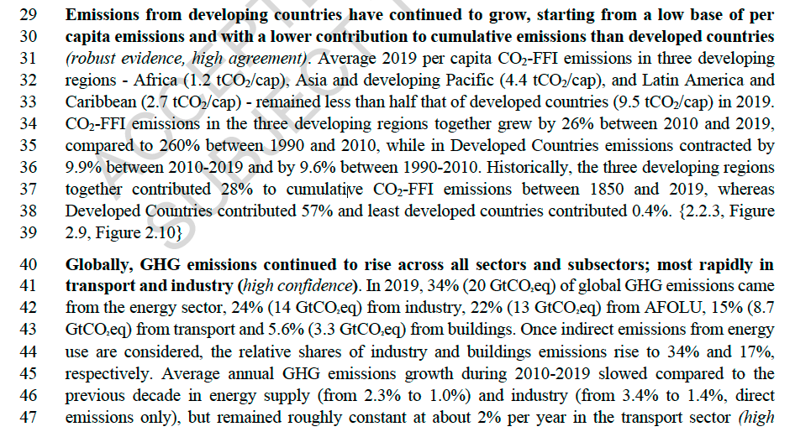
UN IPCC AR6 WG2 Chapter02

Slide 5
Overview
No live stream
Speakers may record themselves but not audience
Chatham_House_Rule
Material CC BY, CC BY-SA, or CC0
Peter Murray-Rust: Knowledge Commons
Joined by:
Shweata N Hegde: semanticClimate
Ananya Singha: Colab Notebooks
Priti Chahal
Ayush Garg: pygetpapers
Manny Faria
Axel Duerkop: infrastructure
Scratchpad at https://pad.riseup.net/p/kgUK6mzTDqVtGllooscH (will be deleted afterwards). Please add questions and comments. We’ll try to address them (voice or text)
Audio discussion

Slide 6
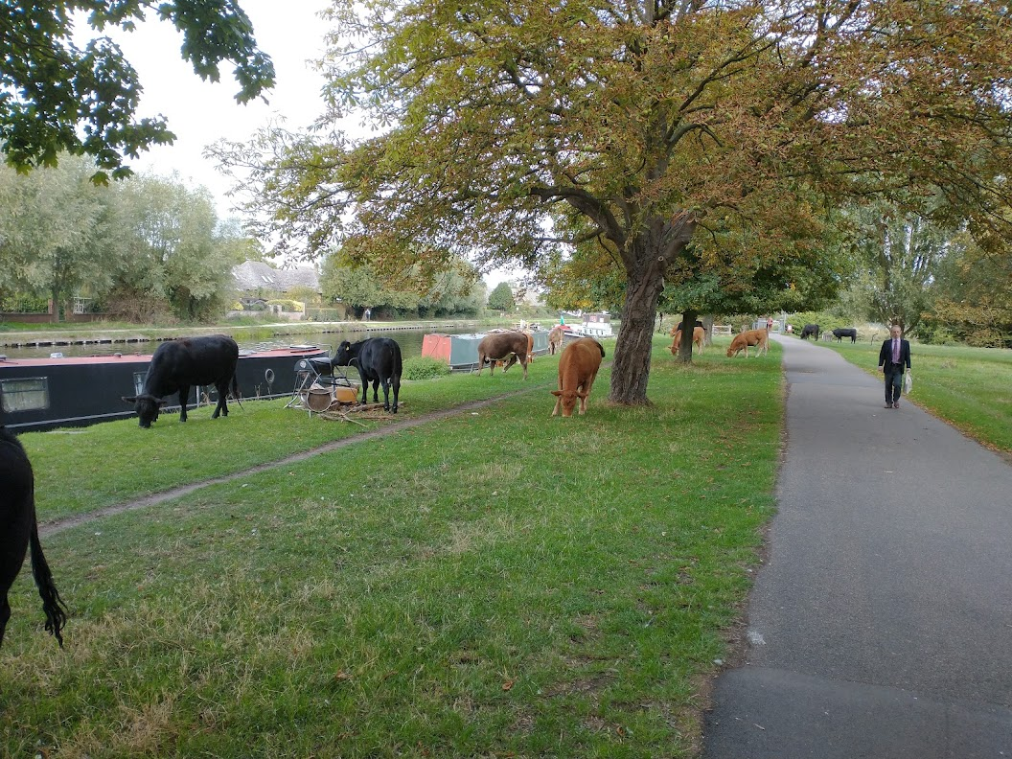
Some Knowledge Commons
Free/open principles Richard_Stallman
Human Genome Project (Bermuda_Principles )
Chemistry community Blue_Obelisk
Wikidata https://Wikidata.org
PyPI Python_Package_Index
Common_land
Common land is land owned by a person or collectively by a number of persons, over which other persons have certain common rights, such as to allow their livestock to graze upon it, to collect wood, or to cut turf for fuel.^{[1]}
(links to https://Wikipedia/wiki/ )
Stourbridge Common, Cambridge,
© CC0, Peter Murray-Rust 2022-09

Slide 7
The_Four_Essential_Freedoms_of_Free_Software
The freedom to run the program as you wish, for any purpose (freedom 0).
The freedom to study how the program works, and change it so it does your computing as you wish (freedom 1). Access to the source code is a precondition for this.
The freedom to redistribute copies so you can help your neighbor (freedom 2).
The freedom to distribute copies of your modified versions to others (freedom 3). By doing this you can give the whole community a chance to benefit from your changes. Access to the source code is a precondition for this.

Slide 8
Bermuda Principles
The three principles retained originally were:
Automatic release of sequence assemblies larger than 1 kb (preferably within 24 hours).
Immediate publication of finished annotated sequences.
Aim to make the entire sequence freely available in the public domain for both research and development in order to maximise benefits to society.

Slide 9
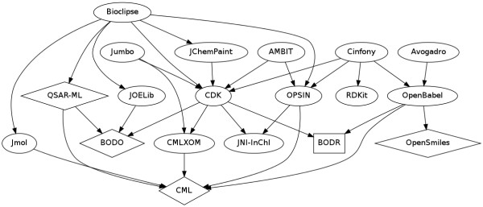
Blue_Obelisk
Blue Obelisk is an informal group of chemists who promote open data, open source,
and open standards; it was initiated by Peter Murray-Rust and others in 2005.^{[1][2][3]}

Slide 10
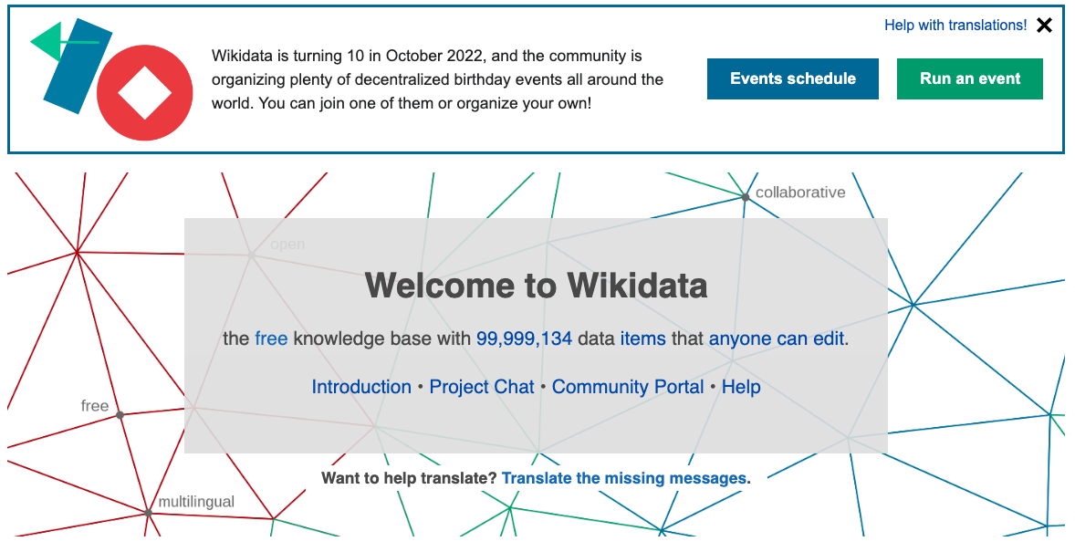

Slide 11
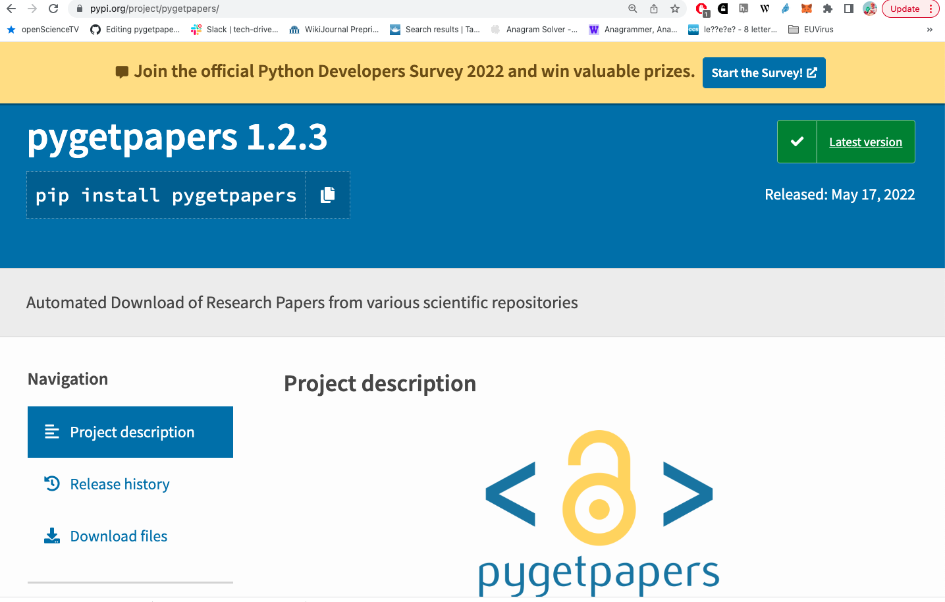
PyPI

Slide 12
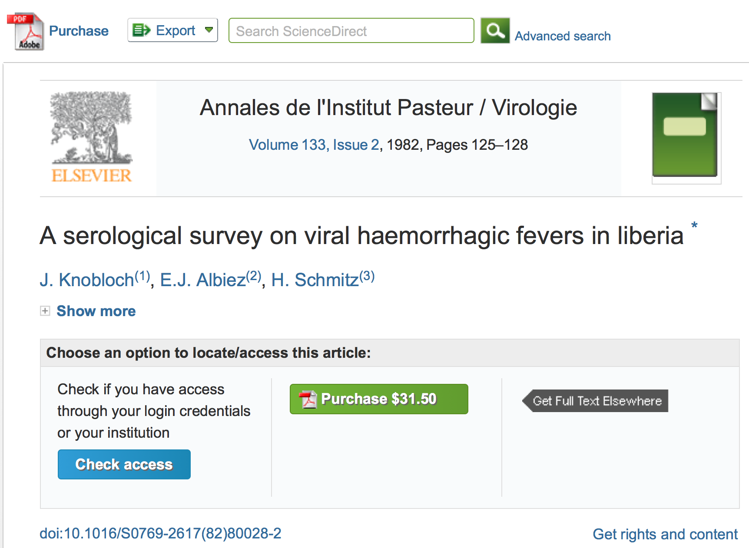
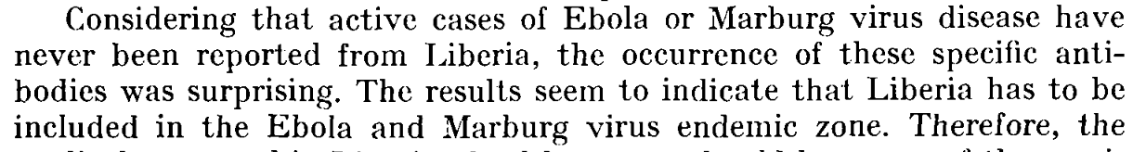
epidemics
Country
Virus

Slide 13
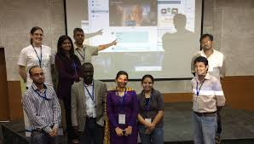
Puneet Kishoor
CODATA/Science Commons
Jenny Molloy
Gita Yadav
Delhi 2014
PMR “met” Gita Yadav for a virtual mini-workshop on text-mining for science…
… starting a 5-year collaboration on Plant Sciences, at NIPGR
(Nat. Inst. For Plant Genome Research).
Gita was then appointed Cambridge-India Lecturer in Plant Sciences…

Slide 14

TIGR2ESS Workshop 2019 Delhi
hunger
ContentMining for Food Security
We built dictionaries for:
Rice
Millets
Maize
And searched EuropePMC
https://www.plantsci.cam.ac.uk/news/tigr2ess-wins-vice-chancellors-collaboration-award 2021
https://tigr2ess.globalfood.cam.ac.uk/events/workshop-r-genomics-and-data-mining

Slide 15
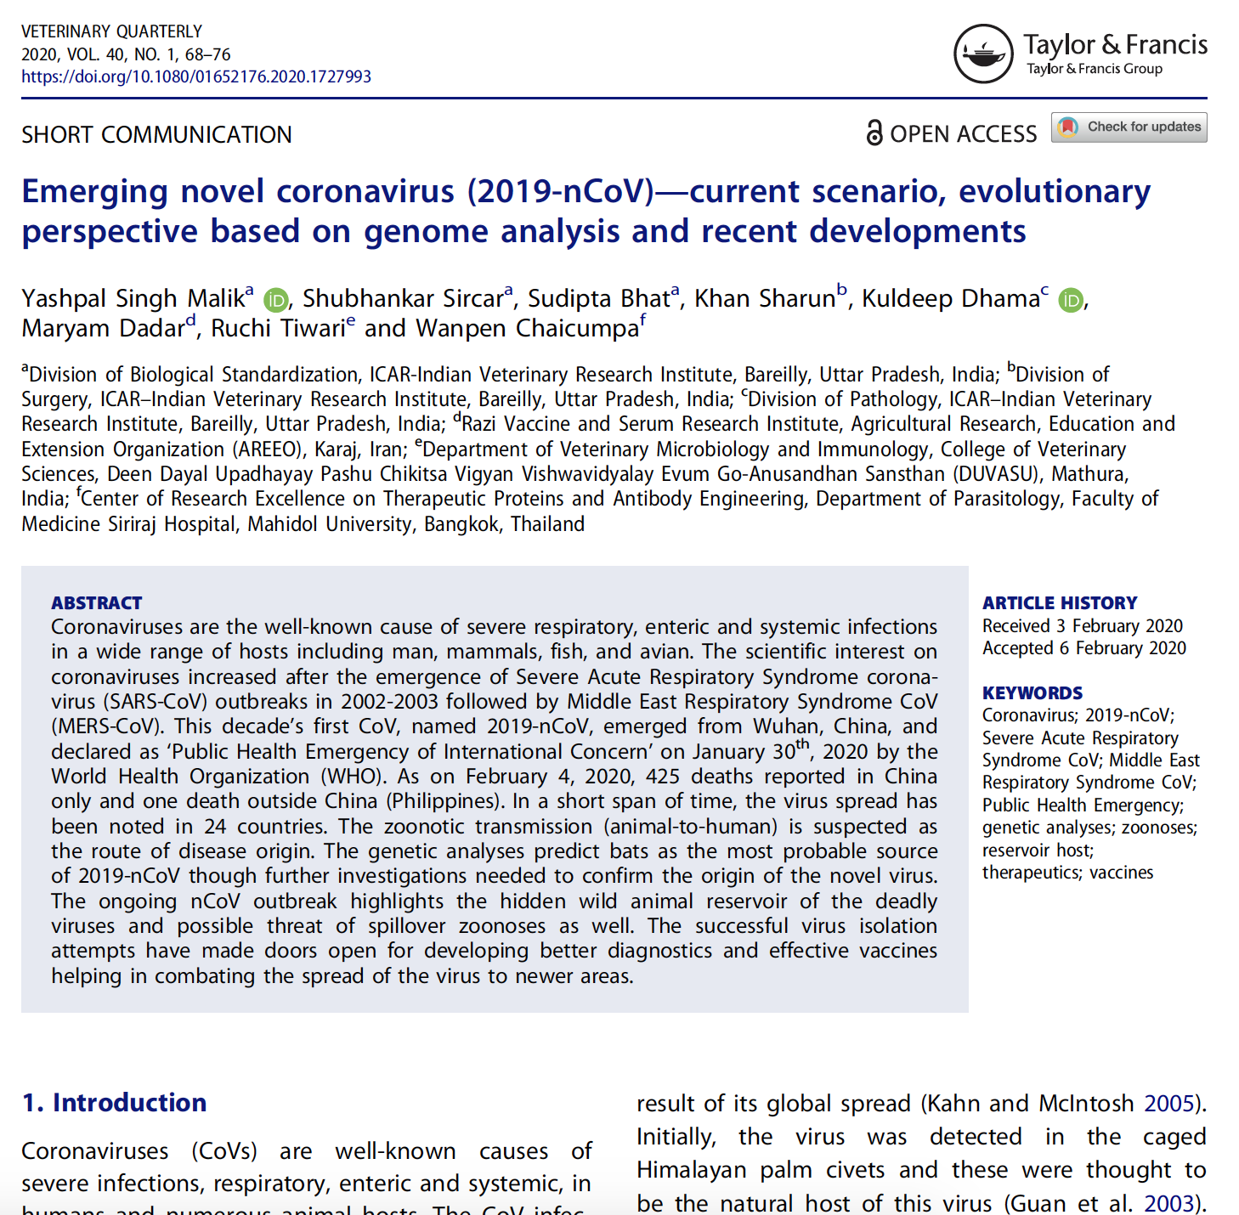
Structure of article
Supervised
Semantic
Facets
Features

Slide 16
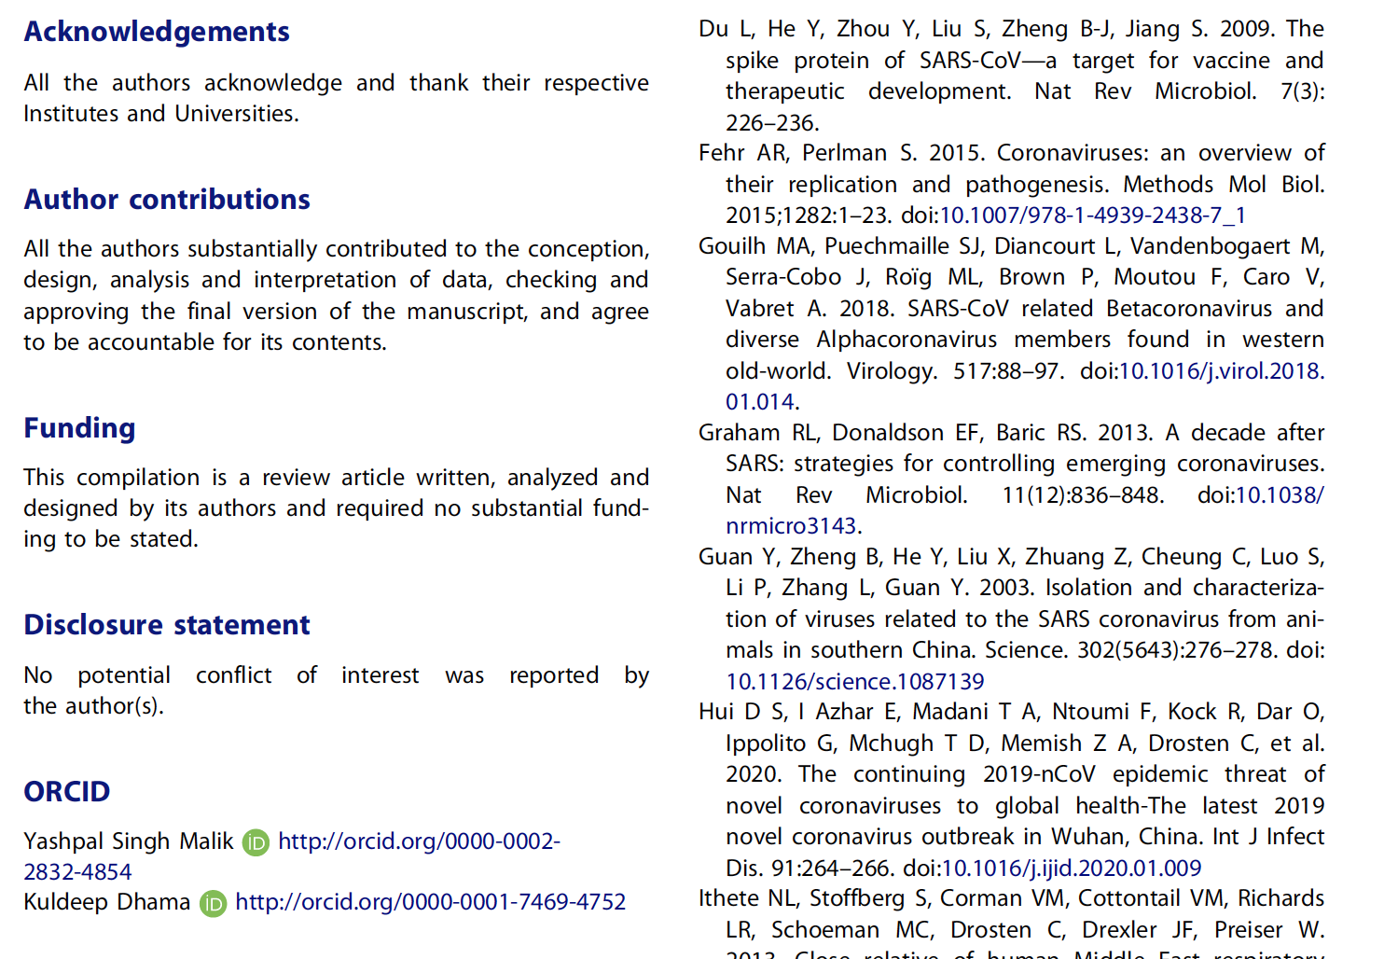
metadata

Slide 17
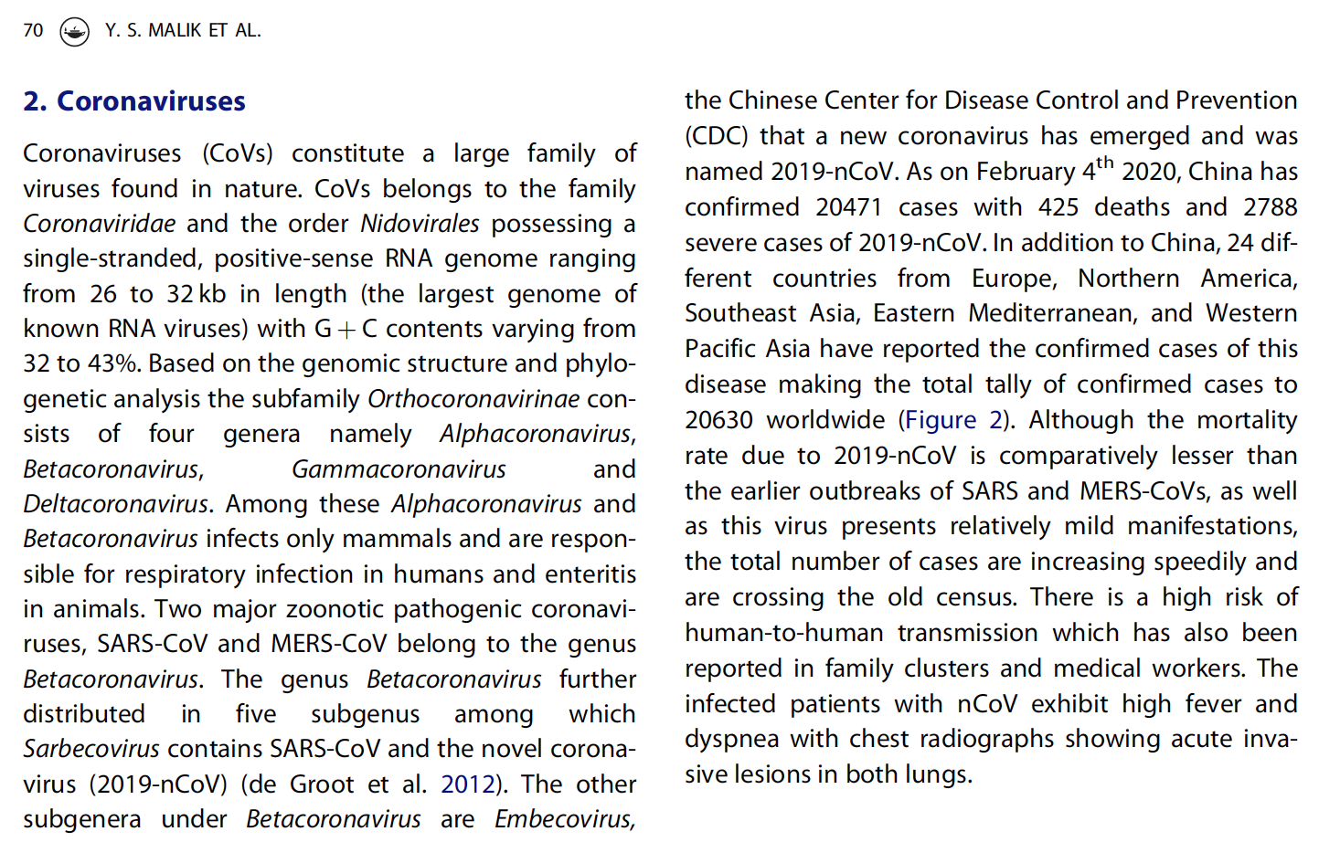
Entities in text
date
virus
country
Nucleic acid
data
genus
disease
role
Med. procedure
symptom
I want to ask: “which countries have SARSC and which have MERS”?
reference
organ

Slide 18
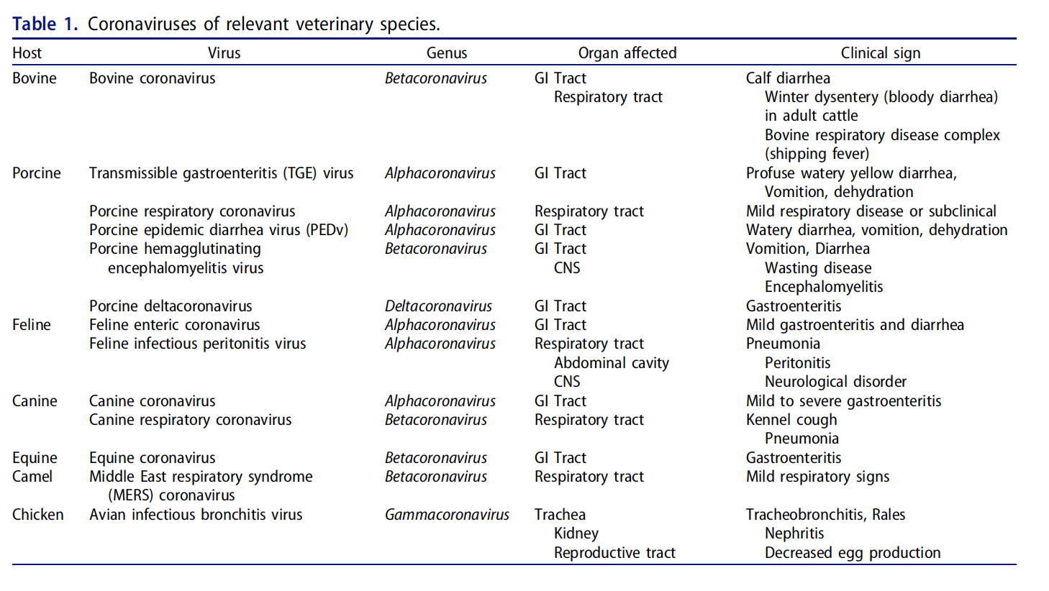
Tables
NO structure in PDF

Slide 19
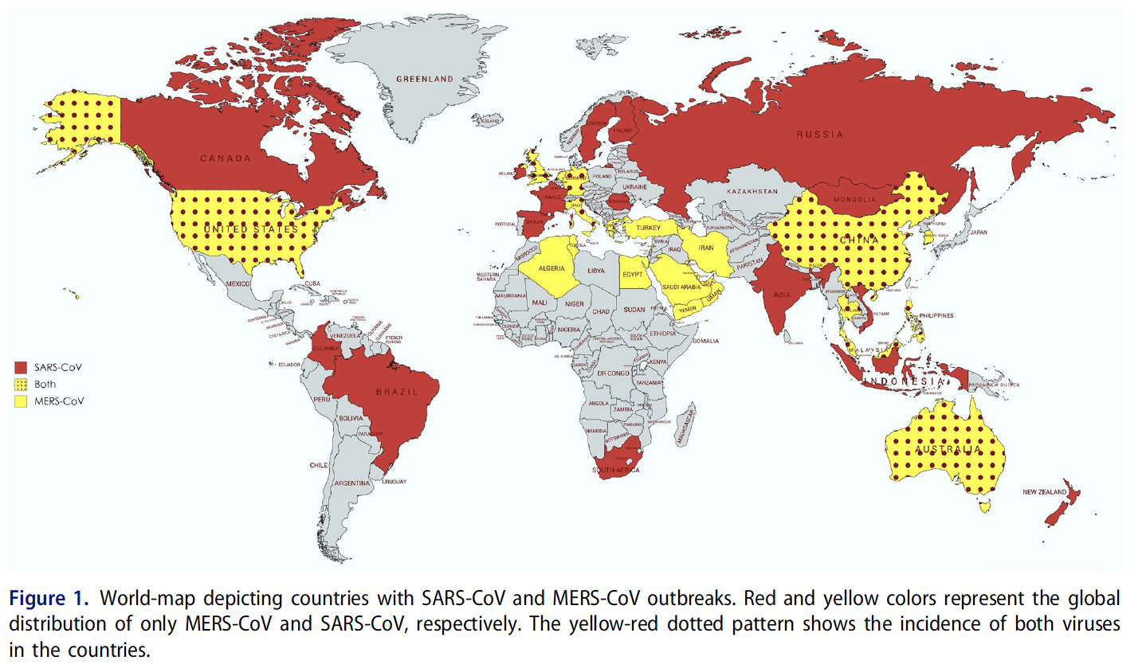
Maps
I want to ask: “which countries have SARS and which have MERS”?

Slide 20
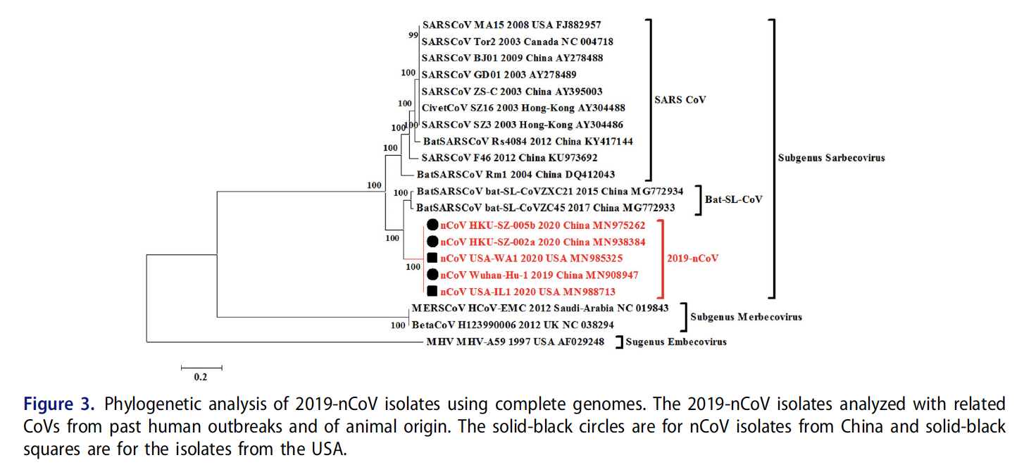
Phylogenetic tree

Slide 21
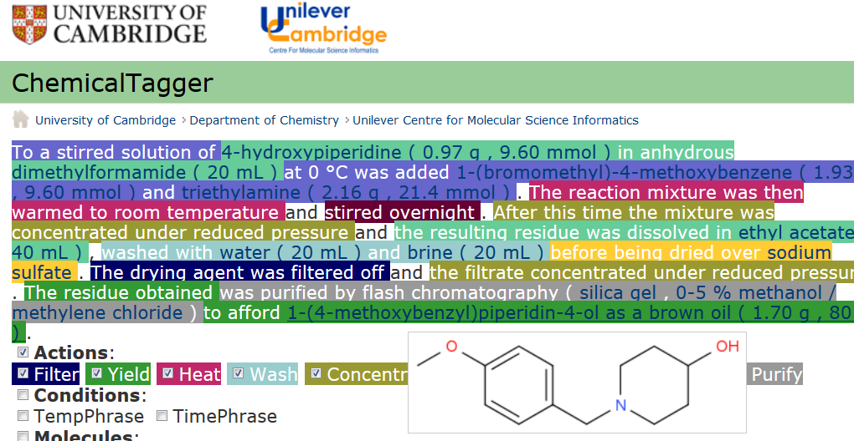
Automatic semantic markup of chemistry
Could be used for analytical, crystallization, etc.

Slide 22
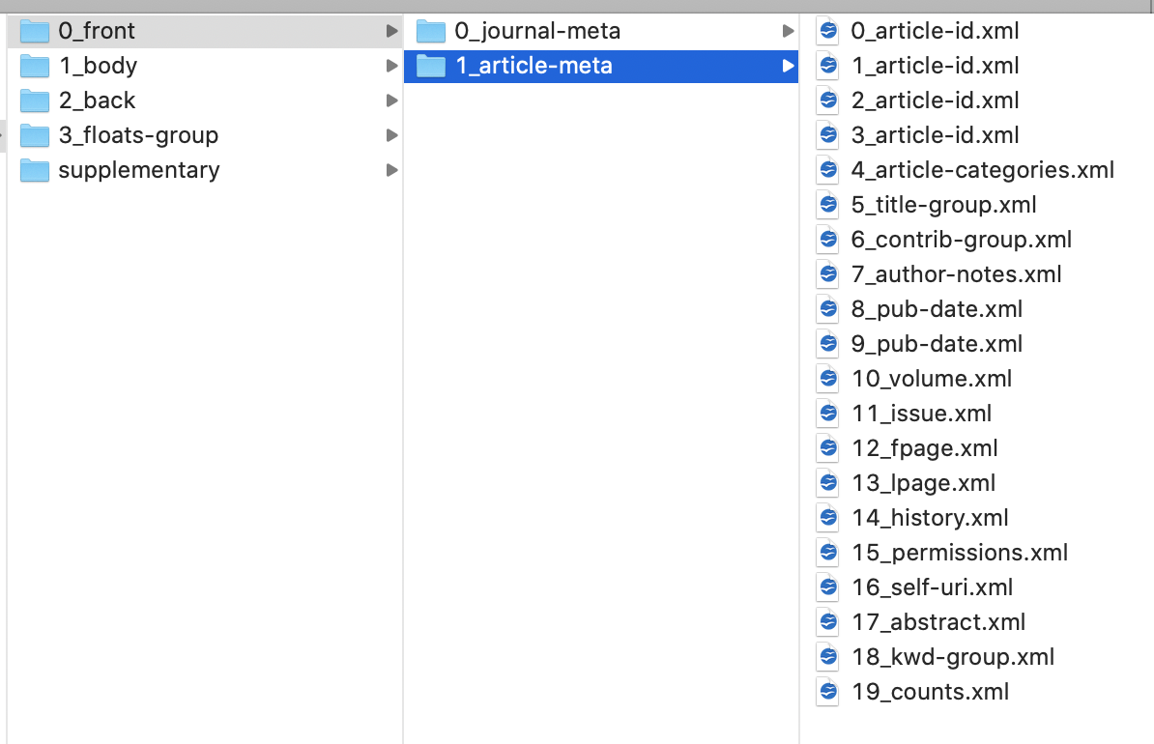
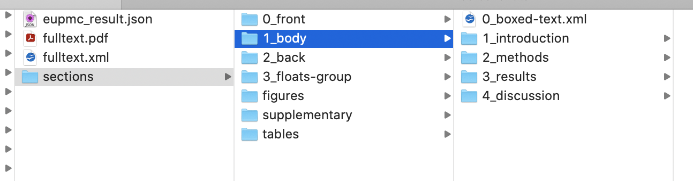
Document structure
Automatically extracted
from JATS-XML by
ami-section

Slide 23
Linked Open Data
things and relations named as http://....… pointing to useful resources
Tim Berners-Lee (2009)
http://wikidata.org/Q42
http://wikidata.org/Q...
http://wikidata.org/P31
https://en.wikipedia.org/wiki/Linked_data#Linked_open_data

Slide 24
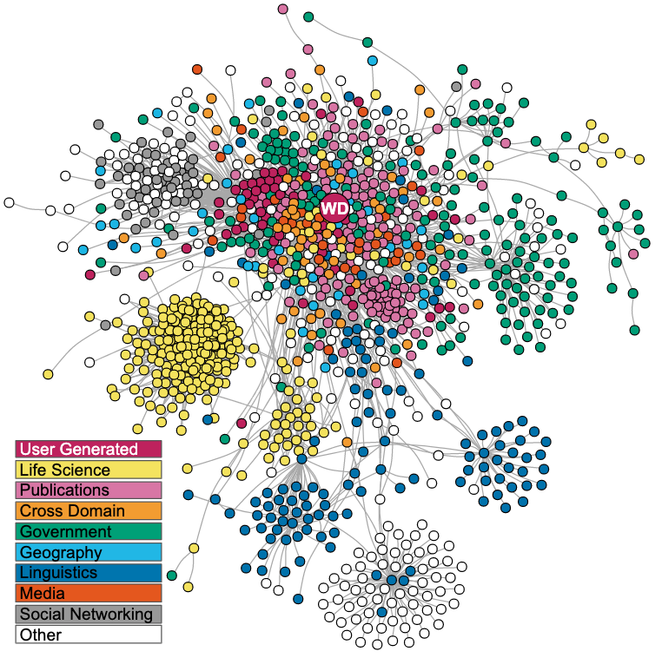
Wikidata Linked Open Data (LOD)
https://en.wikipedia.org/wiki/Linked_data#/media/File:Lod-cloud_2020-08-20.svg
Current:
https://lod-cloud.net/clouds/lod-cloud.svg

Slide 25
https://elifesciences.org/articles/52614
… Wikidata knowledge graph is based on the automated imports of large structured databases via Wikidata bots,
… community-editing model, it harnesses the distributed efforts of a worldwide community of contributors,

Slide 26
pharmaceutical
taxon
therapeutic
gene
disease
pathway
family
pharmacology
Wikidata biomedical entities and relations
medication
protein
anatomy
compound
https://elifesciences.org/articles/52614
Andra Waagmeester + 25 et al

Slide 27
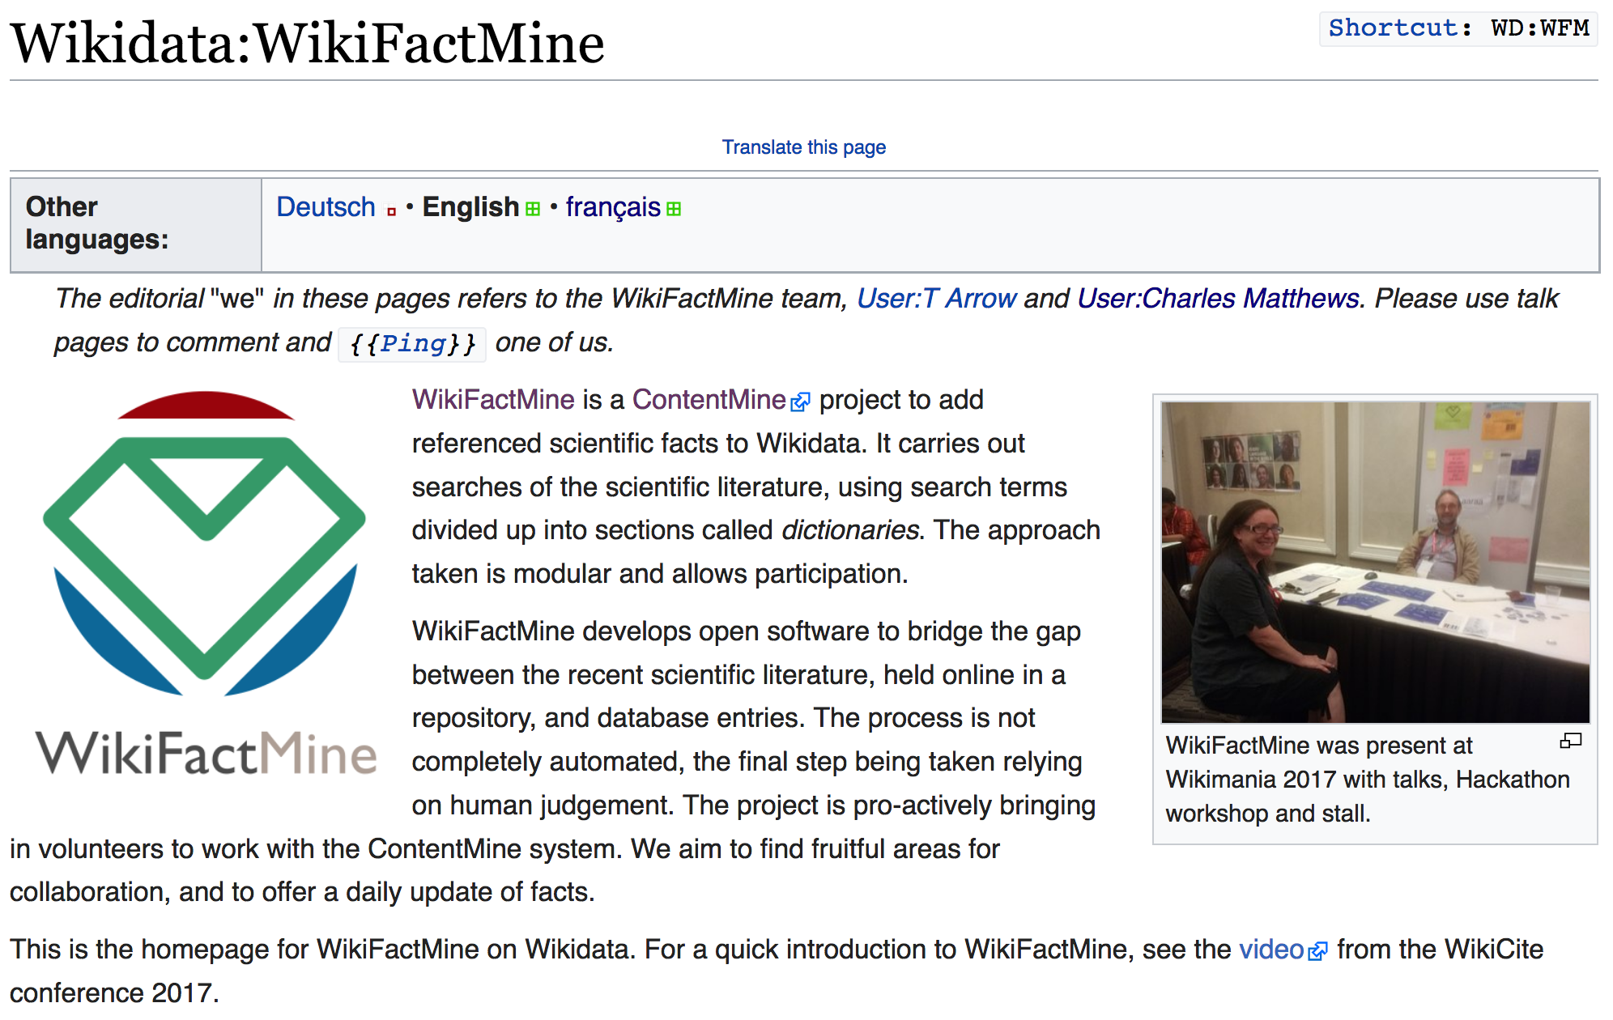

7 million articles, over 200 dictionaries
https://www.wikidata.org/wiki/Wikidata:WikiFactMine
ContentMine thanks the WikimediaFoundation for support

Slide 28
epidemics
Country
Virus

Slide 29
A System Failure of Scholarly Publishing
http://www.nytimes.com/2015/04/08/opinion/yes-we-were-warned-about-ebola.html
We were stunned recently when we stumbled across an article by European researchers in Annals of Virology [1982]: “The results seem to indicate that Liberia has to be included in the Ebola virus endemic zone.” In the future, the authors asserted, “medical personnel in Liberian health centers should be aware of the possibility that they may come across active cases and thus be prepared to avoid nosocomial epidemics,” referring to hospital-acquired infection.
Bernice Dahn (chief medical officer of Liberia’s Ministry of Health)
Vera Mussah (director of county health services)
Cameron Nutt (Ebola response adviser to Partners in Health)

Slide 30
* Shweata Hegde * Ananya Singha, * Ayush Garg * Axel Duerkop #semanticClimate

Slide 31
Additional material

Slide 32
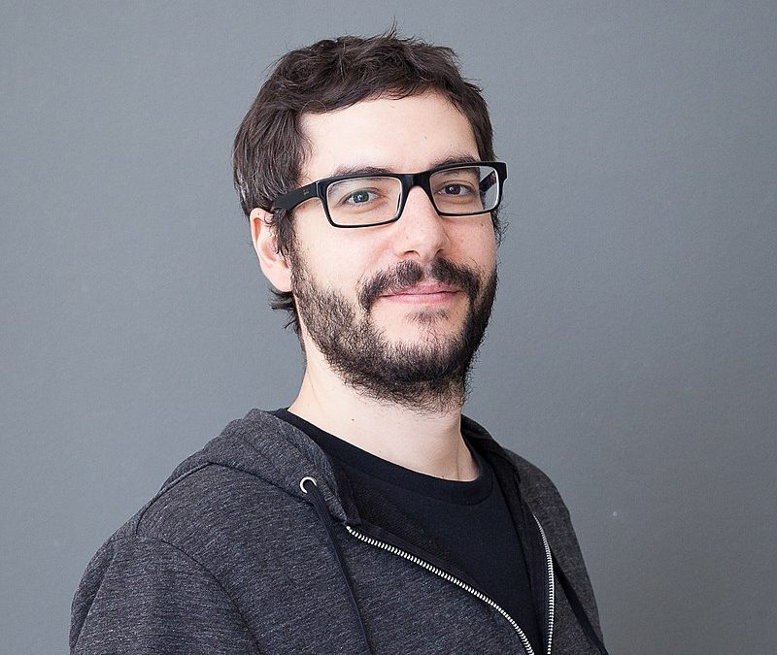
OpenKnowledgeMaps
#DontLeaveItToGoogle
Unsupervised Learning
Or…
...Mendeley
…WebOfScience
…Scopus
… Elsevier
…Springer-Nature
Peter Kraker
An Open Infrastructure is essential
Repositories: BASE , EuropePMC
Free articles: Unpaywall
Preprints: arXiv, bioRxiv, medRxiv
Indexing: Crossref
Metadata: Wikidata
https://elephantinthelab.org/google-and-research-data/

Slide 33
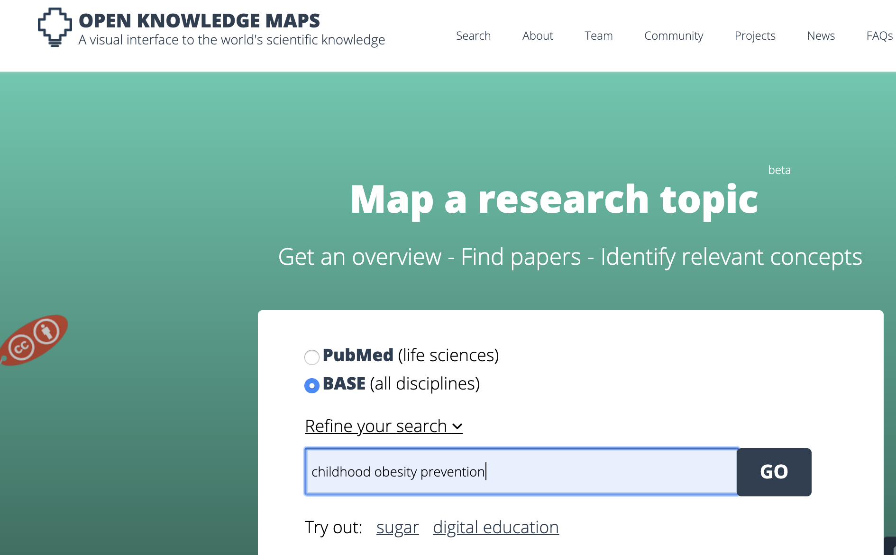
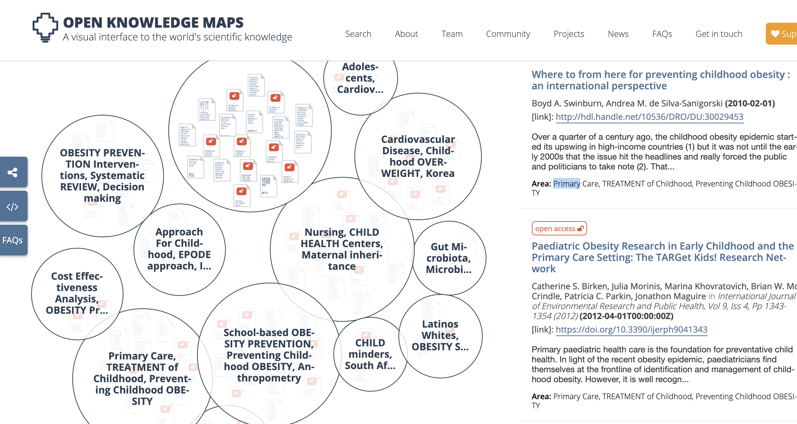
Unsupervised
learning
Unsupervised Learning
Peter Kraker and team
http://openknowledgemaps.org
Let’s ask for “childhood obesity prevention”

Slide 34
Unsupervised
learning
Unsupervised Learning
Peter Kraker and team
http://openknowledgemaps.org
Let’s ask for “childhood obesity prevention”
1 million OKMaps (2022-10-18)

Slide 35
Images
Extraction of features
Extraction of data

Slide 36
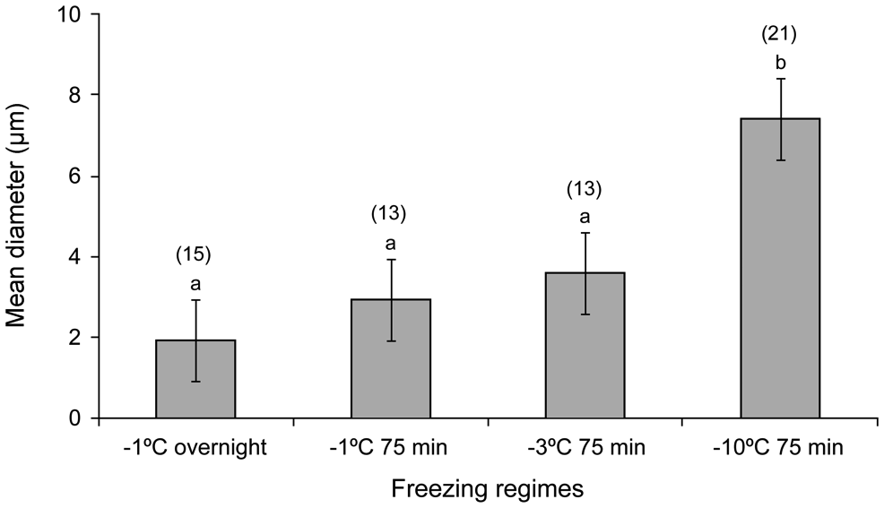
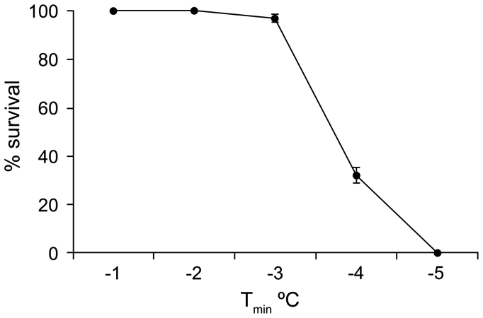
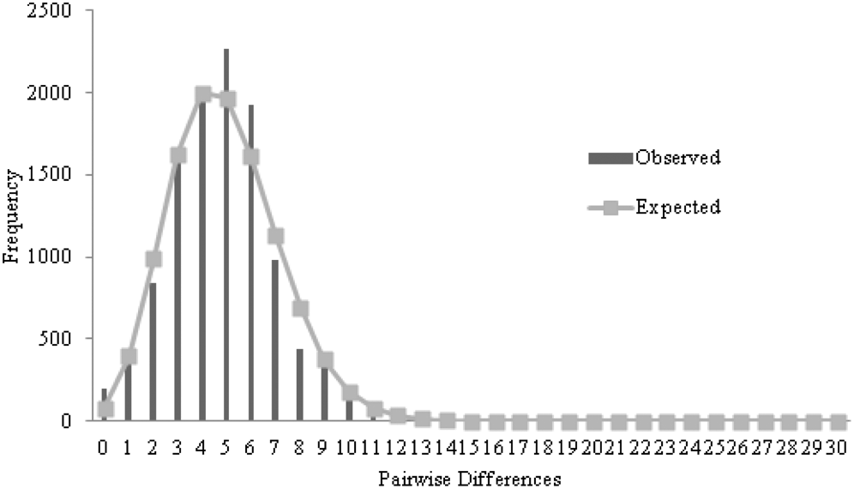
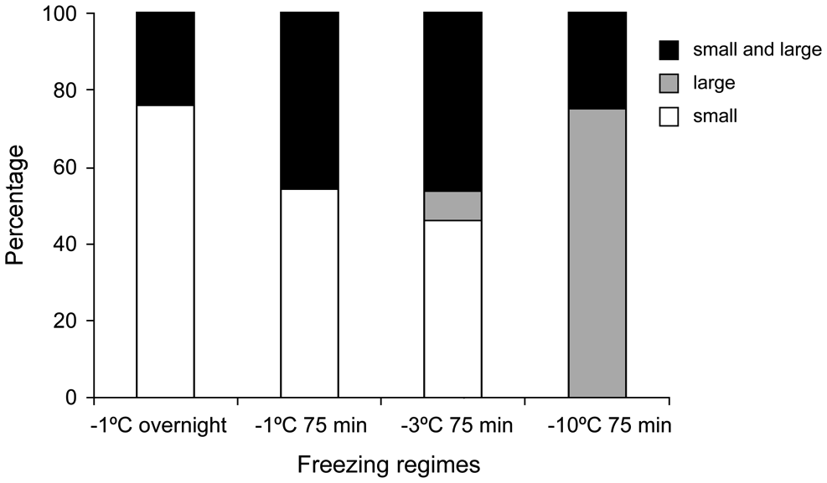
Examples of plots

Slide 37
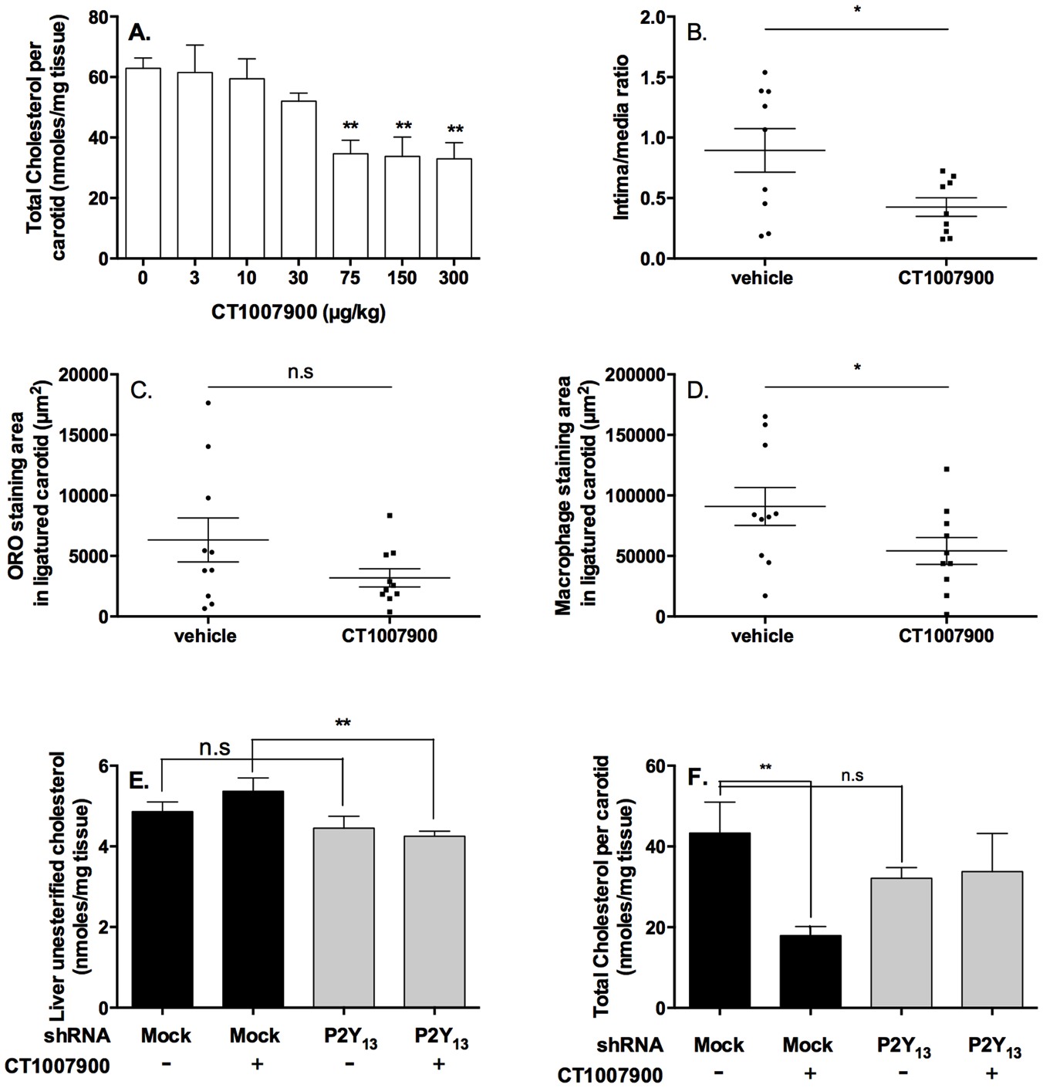
Multisegment diagram

Slide 38
Multisegment diagram
Semantic
labels
Superpixel
Bounding box
Whitespace
“corridors”

Slide 39
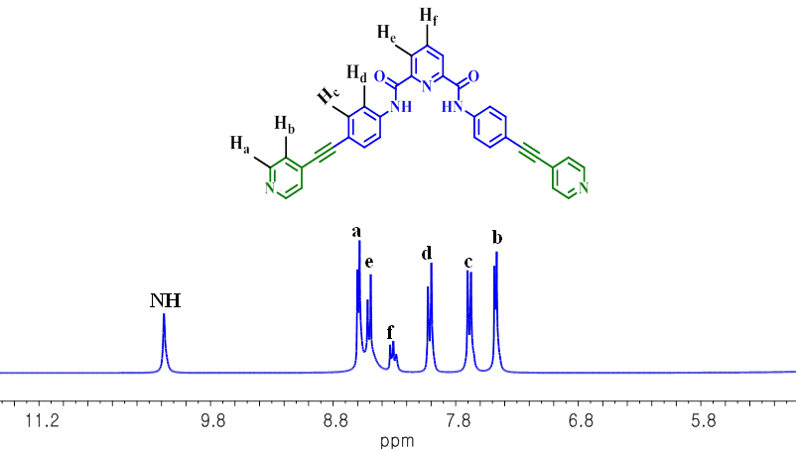

Slide 40
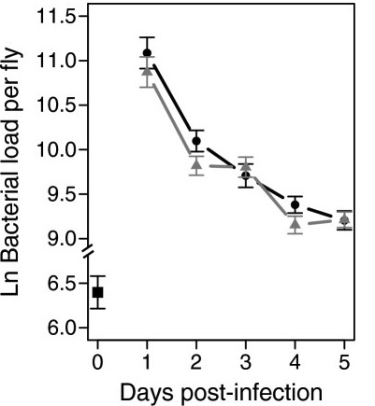
Bitmap Image and Tesseract OCR
11.5
11.0
10.5
10.0
9.5
9.0
6.5
6.0
0 1 2 3 4 5
Ln Bacterial load per fly
Days post—infection

Slide 41
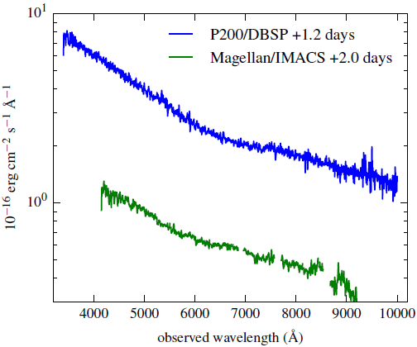
TITLES
VECTOR PDF
DATA!!
2000+ points
UNITS
TICKS
SCALE
QUANTITY

Slide 42
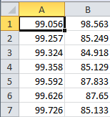
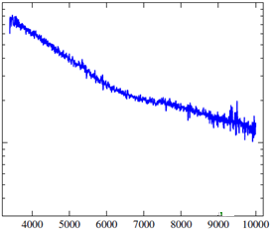
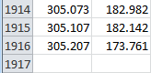
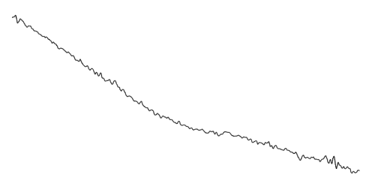

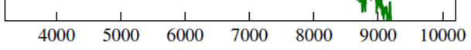
Dumb PDF
Automatic
extraction
CSV
Smoothing Gaussian Filter
Semantic
Spectrum
2nd Derivative

Slide 43
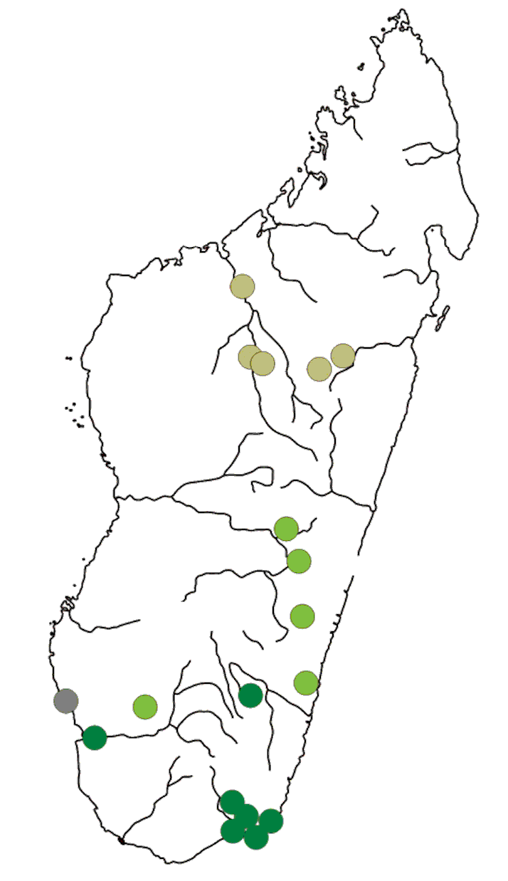

Posterisation
Extracted since unique posterized colour

Slide 44
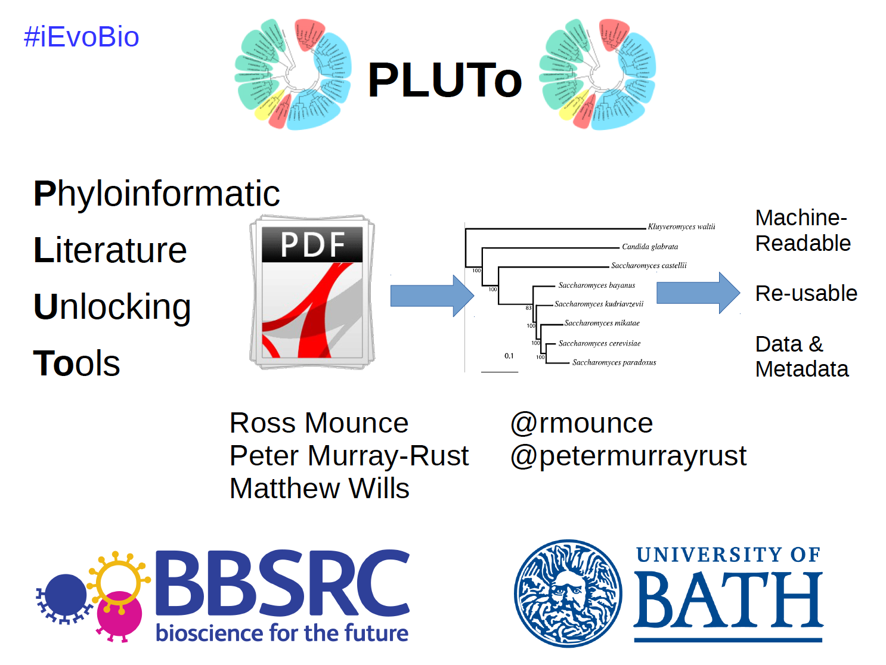
http://www.slideshare.net/rossmounce/the-pluto-project-ievobio-2014

Slide 45
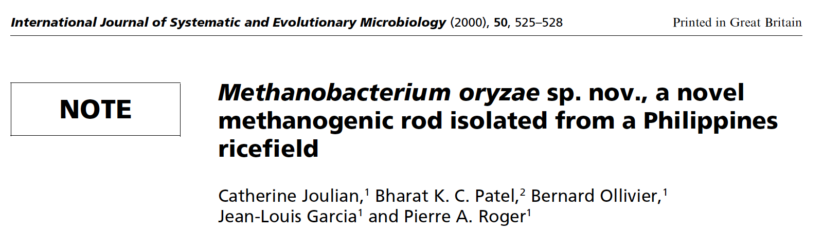
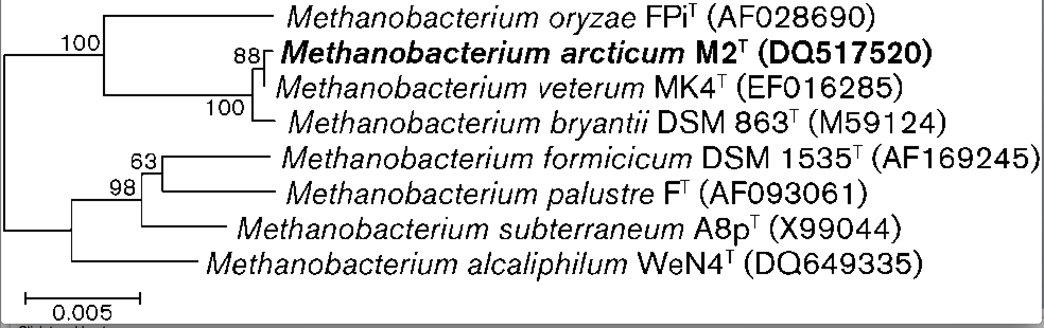
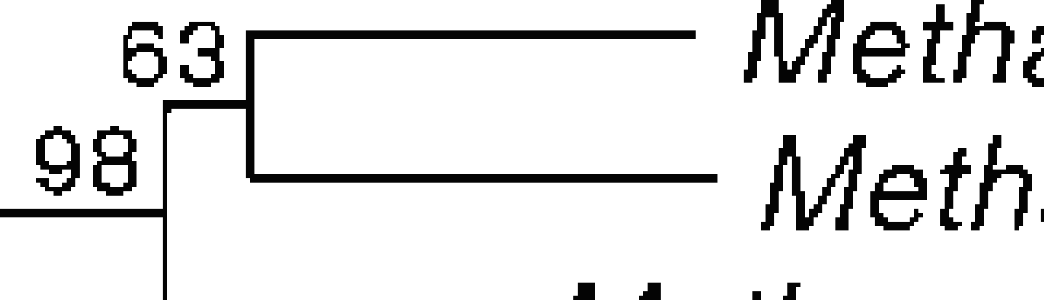
NEW Bacteria must have a phylogenetic tree
Length
_________
Binomial Name
Culture/Strain
GENBANK ID
Weight
Evolution
Rate
Note Jaggy and
broken pixels

Slide 46
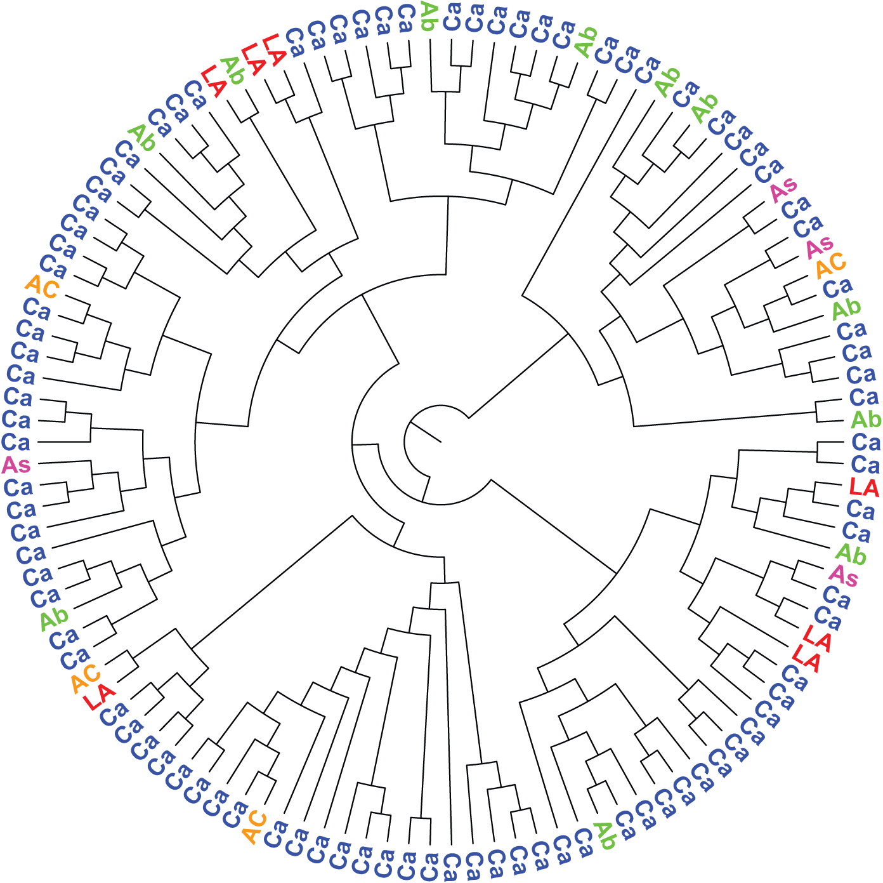
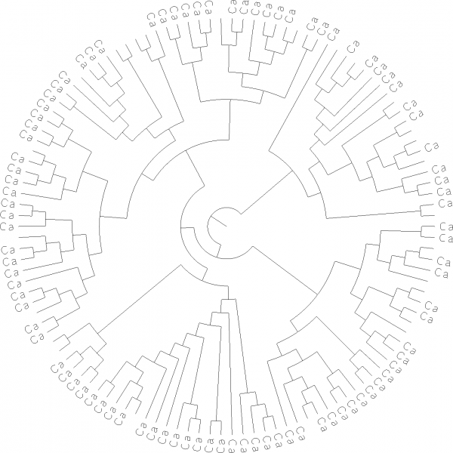
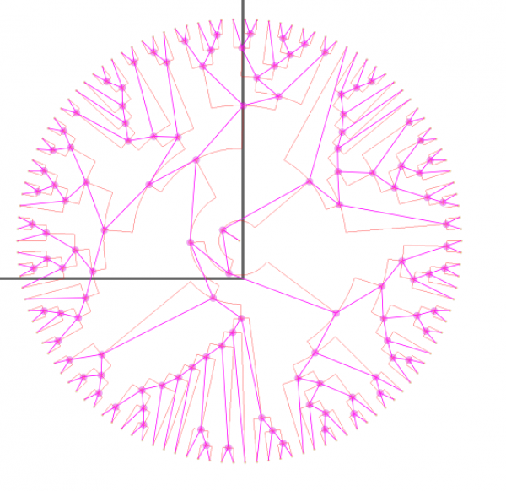
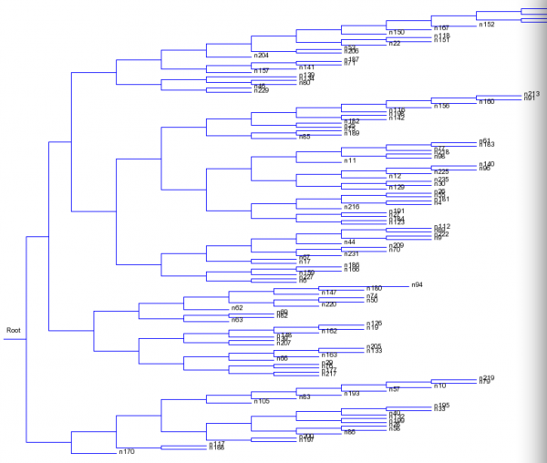
Thinning
Topology
https://blogs.ch.cam.ac.uk/pmr/2014/06/25/content-mining-we-can-now-mine-images-of-phylogenetic-trees-and-more/ for story of extraction
Serialization
Newick

Slide 47
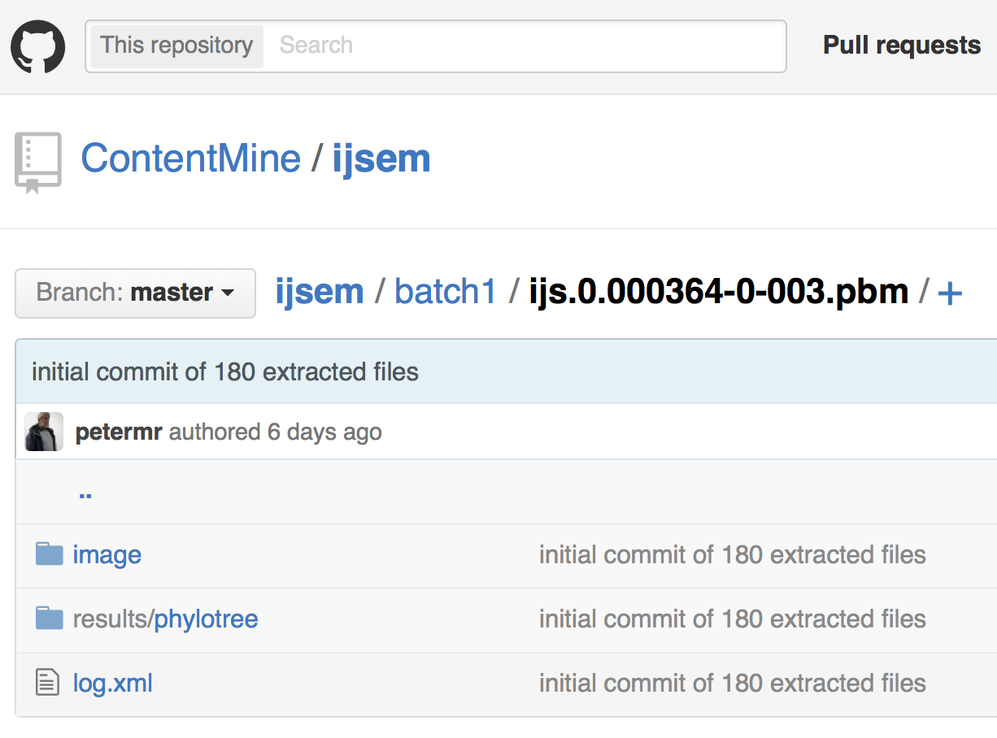
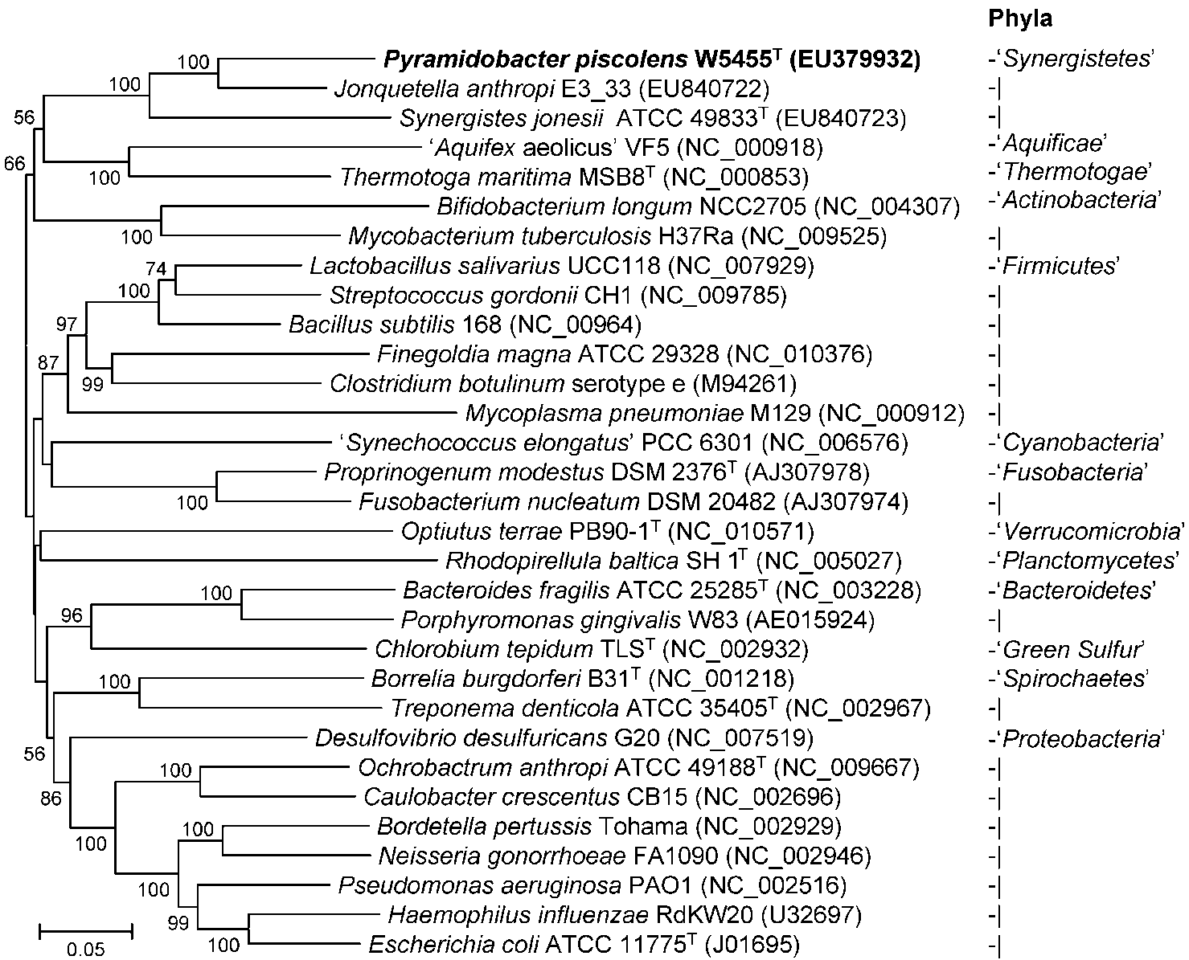
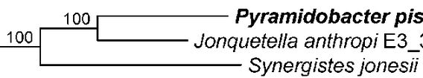
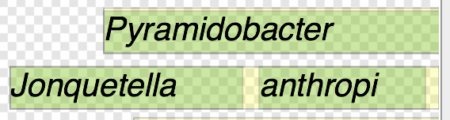
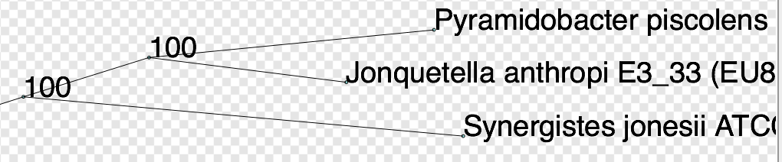
OCR (Tesseract)
Norma (imageanalysis)
(((((Pyramidobacter_piscolens:195,Jonquetella_anthropi:135):86,Synergistes_jonesii:301):131,Thermotoga_maritime:357):12,(Mycobacterium_tuberculosis:223,Bifidobacterium_longum:333):158):10,((Optiutus_terrae:441,(((Borrelia_burgdorferi:…202):91):22):32,(Proprinogenum_modestus:124,Fusobacterium_nucleatum:167):217):11):9);
Semantic re-usable/computable output (ca 4 secs/image)

Slide 48

Copyright, Open Access, and Human Rights
March 13, 2015 Kevin Smith, J.D. 2 Comments
The United Nations Human Rights Council … a report from Farida Shaheed, who is a “Special Rapporteur” in the area of “cultural rights.”
… its frank recognition that intellectual property laws are in tension with the fundamental human right of access to science and culture … WIPO is charged, whether effectively or not, to find ways to facilitate open access to science and culture …
this is not just a “what’s best for academia and for my interests” issue, but a true human rights issue. Ms. Shaheed’s report makes this case in a concise and compelling way … - See more at: http://blogs.library.duke.edu/scholcomm/2015/03/13/copyright-open-access-and-human-rights/#sthash.6CQiMoiV.dpuf

Slide 49


Supertree for 924 species
Tree

Slide 50

Supertree created from 4300 papers

Slide 51



Slide 52


C) What’s the problem with this spectrum?
Original thanks to ChemBark
Org. Lett., 2011, 13 (15), pp 4084–4087
Notes:
ChemBark

Slide 53

After AMI2 processing…..
… AMI2 has detected a square

Slide 54


Slide 55
Ethics and Politics

Slide 56

Elsevier stopped me doing my research
Chris Hartgerink
@Senficon (Julia Reda) :Text & Data mining in times of #copyright maximalism:
"Elsevier stopped me doing my research" http://onsnetwork.org/chartgerink/2015/11/16/elsevier-stopped-me-doing-my-research/ … #opencon #TDM

Slide 57
The Publisher-Academic complex[1]
$$, MS
review
Taxpayer
$$
$$
Publishers
Academia
Student
Glory+?
in-kind
Infrastructure
Researcher
“The scholarly poor”
[1] The Military-Industrial-Academic complex (1961)
(Dwight D Eisenhower, US President)

Slide 58

https://www.youtube.com/watch?v=zxKPsueoFBo

Slide 59
BENEFITS OF CONTENT MINING
Hague Declaration 2015
Addressing grand challenges such as climate change and global epidemics
Improving population health, wealth and development
Creating new jobs and employment
Exponentially increasing the speed and progress of science through new insights and greater efficiency of research
Increasing transparency of governments and their actions
Fostering innovation and collaboration and boosting the impact of open science
Creating tools for education and research
Providing new and richer cultural insights
Speeding economic and social development in all parts of the globe

Slide 60
thanks
India interns
Ambreen Hamadani Anugrah S. R. Charles Zeyang Li Kareena Singh Lakshmi Devi Priya Pruthiv Rajan Karunakaran Shweata N. Hegde Sana Saifi Vaishali Arora Vanisha Arora Dheeraj Kumar Jitu Ram Bhargav Om Prakash Mehra Pooja Pareek Simranleen Singh Urja Biswas Aishwarya Dharan Ayush Garg Mukul Bhambri Padmini Rai Ebhoimen Israel
Gitanjali Yadav (Delhi/Cambridge)
Wikimedia (Brazil) Redalyc (Mexico)

Slide 61
BENEFITS OF CONTENT MINING
Hague Declaration 2015
Addressing grand challenges such as climate change and global epidemics
Improving population health, wealth and development
Creating new jobs and employment
Exponentially increasing the speed and progress of science through new insights and greater efficiency of research
Increasing transparency of governments and their actions
Fostering innovation and collaboration and boosting the impact of open science
Creating tools for education and research
Providing new and richer cultural insights
Speeding economic and social development in all parts of the globe

